Slide 1






SIGN2CONNECT
DIGITAL INNOVATORS
TEAM NAME : Fusion Divas
MEMBERS :
1. Keertana Priya A
2. Priyadharshini S K
3. Rajeshwari S
MENTOR NAME: Mrs.M.Soundarya
COLLEGE NAME: Velammal College of Engineering and Technology, Madurai

Slide 2

PROBLEM STATEMENT
Despite the importance of communication in education and workplaces, mute and deaf individuals still face exclusion due to limited sign language awareness and missing real-time support.
Current solutions rely on interpreters or typing, making live participation slow, dependent, and unsuitable for presentations or meetings.
Mute and deaf individuals are directly affected, along with students, educators, employers, organizations, and event audiences.
The absence of real-time Sign-to-Speak and Speak-to-Sign systems, interpreter dependency, accuracy gaps, and privacy concerns remain key barriers.

Slide 3
PROPOSED SOLUTION
A bridge between silence and sound that enables instant Sign-to-Speak and Speak-to-Sign communication naturally and in real time.
Objectives To empower mute and deaf individuals with independent communication and create truly inclusive classrooms and workplaces.
Key Features
Live two-way translation between signs and speech.
Hands-free interaction for meetings and presentations.
Accessible, scalable, and user-friendly design.
How It Solves the Problem By turning signs into voice and voice into visual language, it removes dependency and makes communication effortless for everyone.

Slide 4
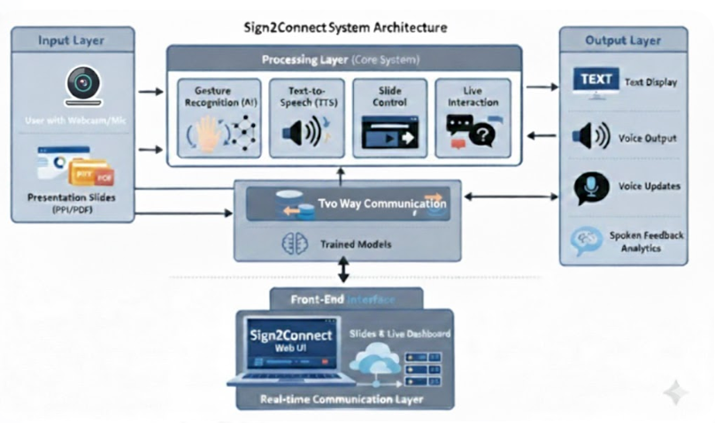

SYSTEM ARCHITECTURE

Slide 5
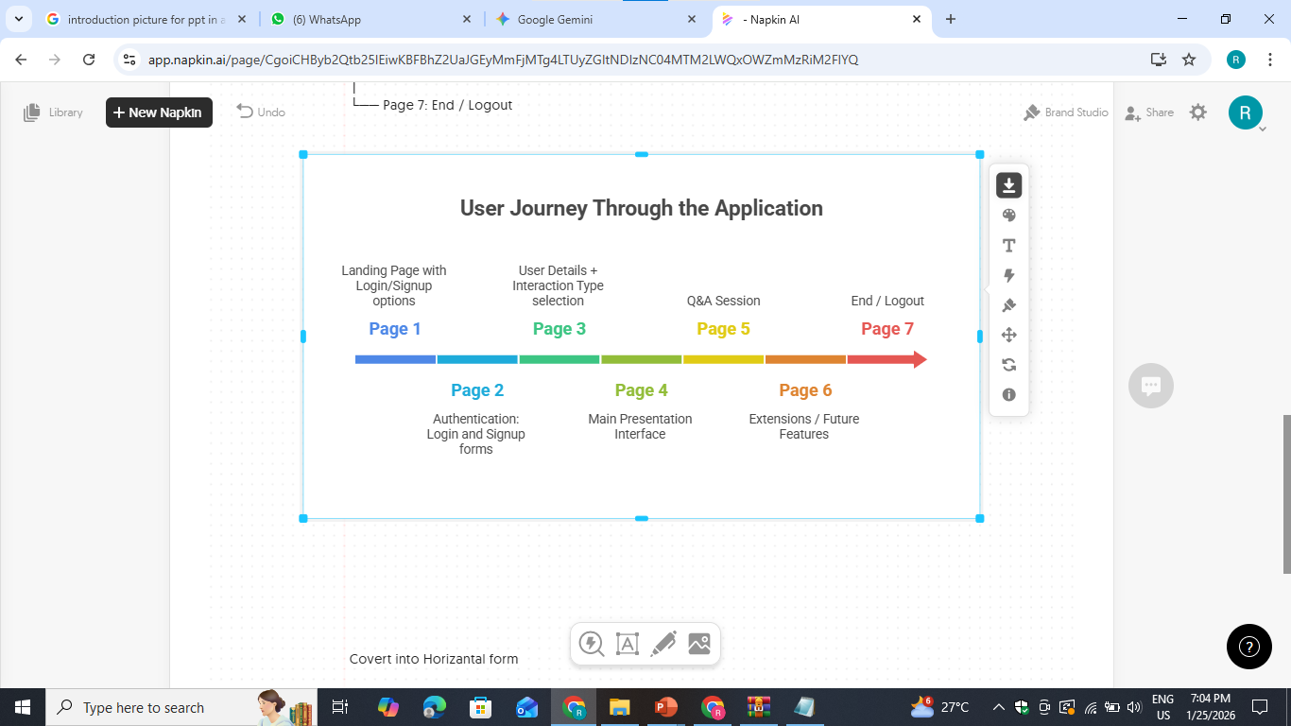
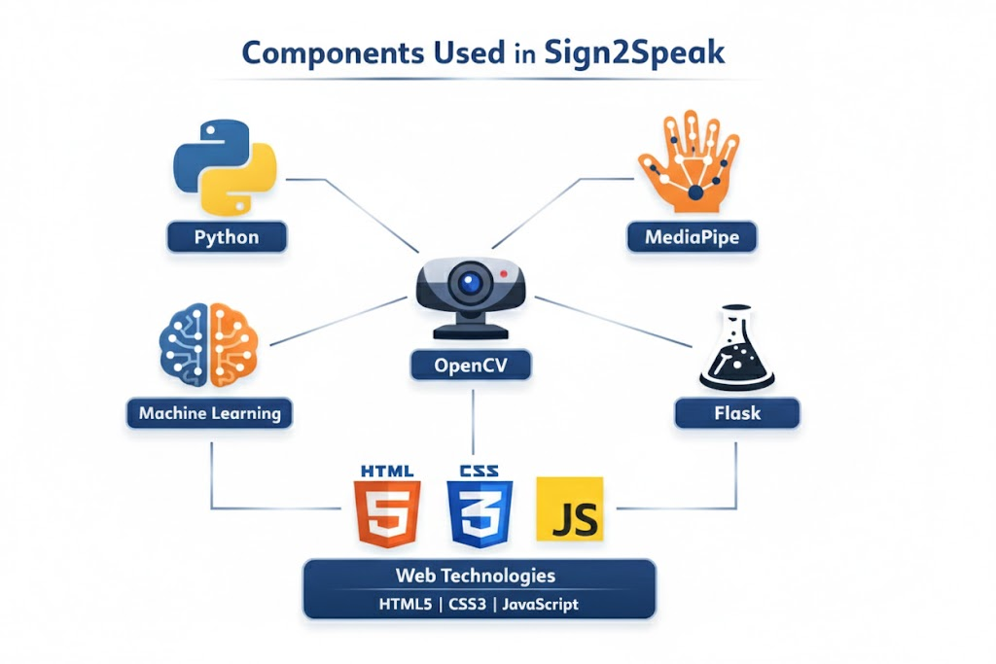
WORK FLOW AND COMPONENTS

Slide 6
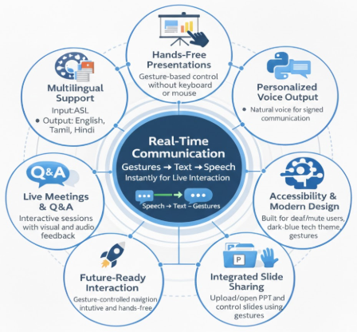
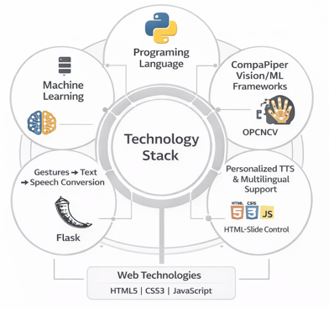
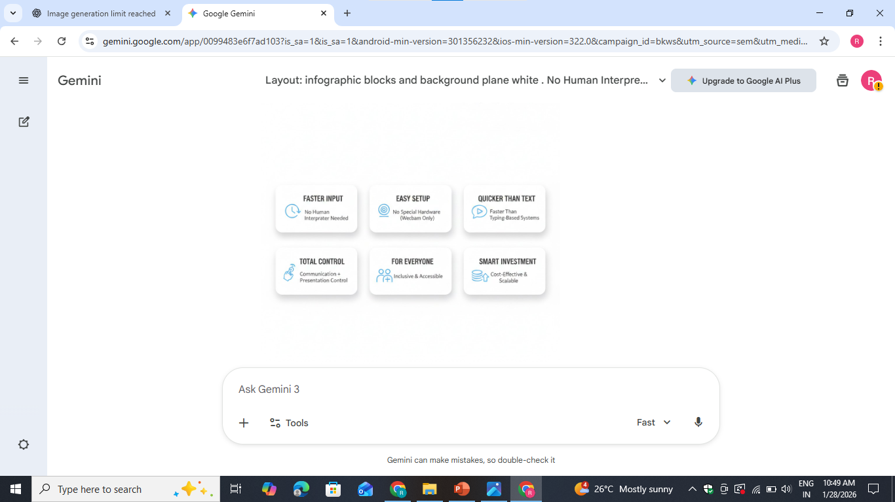
TECHNOLOGY STACK AND INNOVATION

Slide 7
IMPACT AND FUTURE SCOPE
Social Impact
Encourages independent and inclusive communication
Strengthens accessibility in education and public speaking
Technical Impact
Advances real-time speak-to-sign interaction systems
Promotes hands-free intelligent technologies
Economic Impact
Minimizes reliance on human interpreters
Offers an affordable, scalable assistive solution
Benefits
Deaf and mute community
Teachers, students, and presenters
Inclusive organizations and institutions
Expansion & Scalability
Support for multiple sign and spoken languages
Web-based deployment for global reach
Integration with virtual meetings and e-learning systems
Future Scope & Impact
🎤➡️🤟 Bidirectional Speak-to-Sign Communication
🧠📈 Enhanced Recognition Accuracy
😊🔊 Emotion-Sensitive Natural Speech Output
📱 Cross-Platform Mobile Solution

Slide 8

THANK YOU
Do you have any questions?
Contact:
keerty813@gmail.com
priyaselvan0605@gmail.com
rajeshwarismdu@gmail.com

